Slide 1
What is CPSEC?
+ General Security Tips & Advice
Jaxon Haws

Slide 2

Who am I?
Hello, World!
3rd Year Computer Science
Clubs:
White Hat: President
CPLUG: President
Security Engineering @ Fortune 50
Attended DefCon 29 this year
Rock climbing

Slide 3
Our New Name
Cal Poly Security Education Club
CPSEC

Slide 4
Our old Name
A white hat [hacker] is an ethical computer hacker, or a computer security expert, who specializes in penetration testing and other testing methodologies that ensure the security of an organization's information systems.
White Hat

Slide 5




TLDr: We're the same club
Many Logos
Working on transition to new name
Same people, same goals
Graphic Designers?

Slide 6
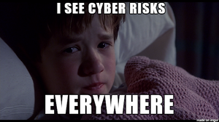
General Goals
don't use password for your password
Help people protect their stuff
Create secure systems
Teach general security knowledge
Low pressure environment

Slide 7

What do we do?
Sorry we don't have merch yet...
Hacking & Shenanigans (In the lab)
Education (Technical Talks)
Social Events

Slide 8
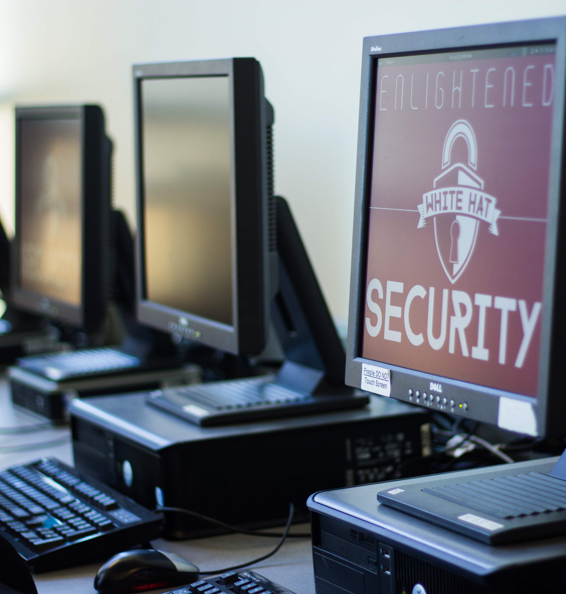


(Ethical) Hacking
Lab is Closed... But it might actually be open
The Lab
CTFs
Isolated Network
Malware Tech Team?

Slide 9

Education
The E
Technical Talks
Tech Teams
Lock Picking
Malware

Slide 10
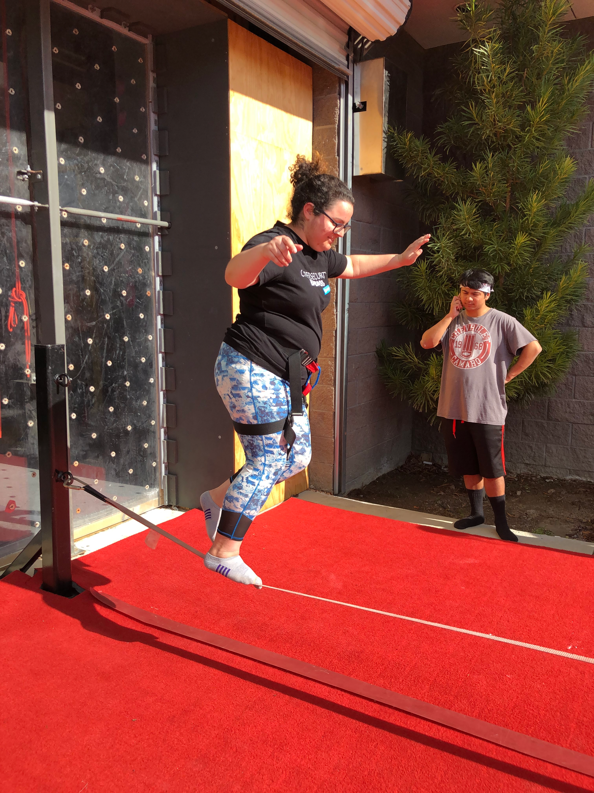
Fun
Previous Events Include:
Donut Walk
Climbing at the Pad
Beach Day
Board Game Night
Hanging out in the Lab

Slide 11
General Security Tips

Slide 12
Tip #1: Passwords

Slide 13


Get a Password Manager
You have no excuse not to
Recommendations:
Use a very strong password you can remember for your vault
Let the password manager generate the rest of your passwords
Download the App on your phone (and browser extension)and give it permissions to autofill
Bitwarden
Cal Poly students get LastPass Premium for FREE (all 4 years)

Slide 14
Tip #2: Privacy

Slide 15
Opt out of the Directory
Try and look me up
Anyone with a portal login can look you up in the directory
Information includes:
name
email
phone number
major

Slide 16
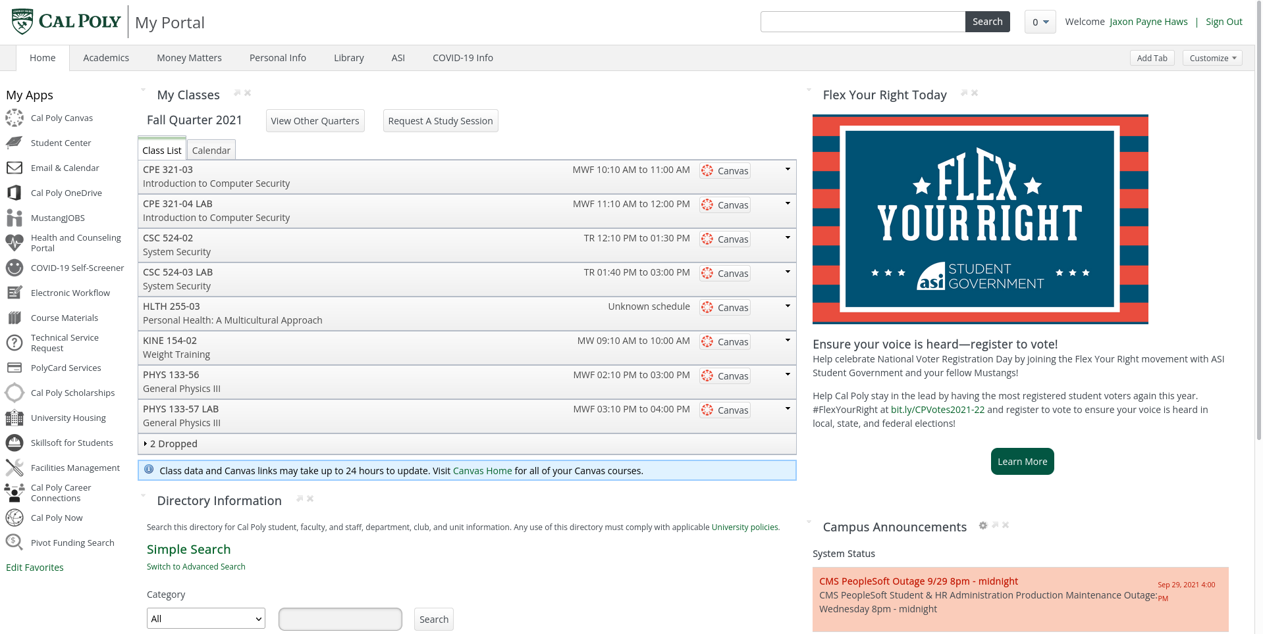

Slide 17
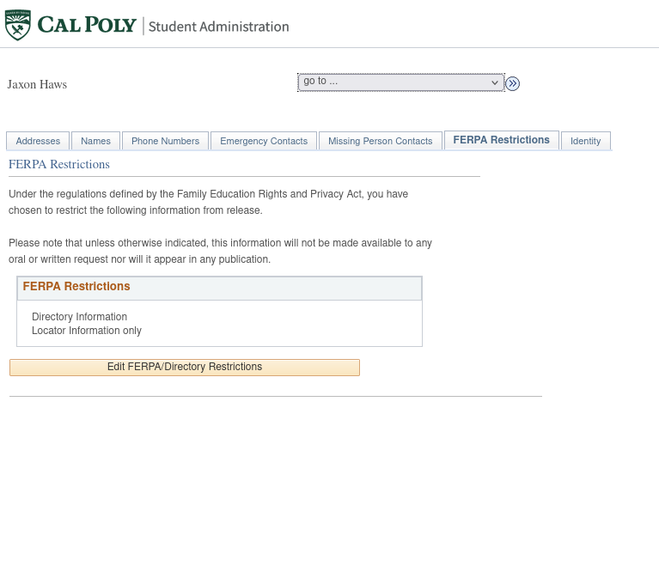
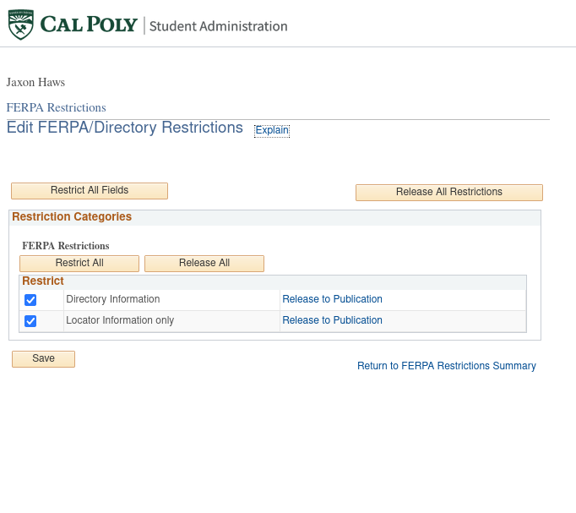

Slide 18
Tip #3: Classes

Slide 19

Take Security classes
The Security Professors are the best
CPE 321: Intro to Security
CSC 323: Cryptography Engineering
CPE 422: Network Security
CSC 424: Software Security
CPE 425: Wireless Security
CPE 426: Introduction to Hardware Security
CSC 429: Current Topics in Computer Security
CSC 521: Computer Security (Grad Class)
CSC 524: System Security (Grad Class)

Slide 20
Tip #4: Concentration

Slide 21
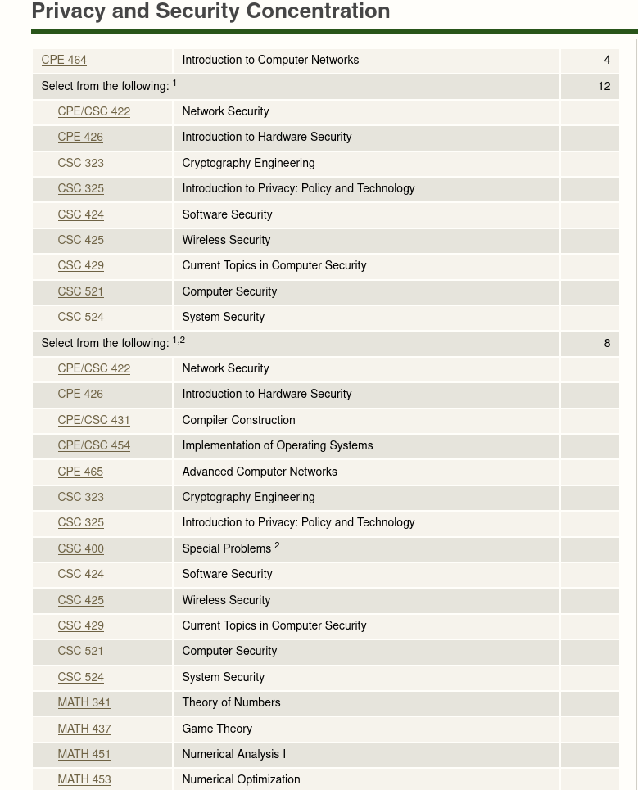
Privacy and Security Concentration
Woo More Security
New for 2021-22 Catalog

Slide 22
Tip #5: Conferences

Slide 23

Conferences
10/10 would recommend
DEF CON
Local BSides Chapter
Grace Hopper
WiCyS
Other Local Conferences

